Slide 1
DevOps in the Cloud at Microsoft and Netflix
Claude Remillard, Microsoft
Andy Glover, Netflix

Slide 2

Automated Pipeline
Automates Deployments
Build
DEV
INT
QA
PROD

Slide 3


Slide 4
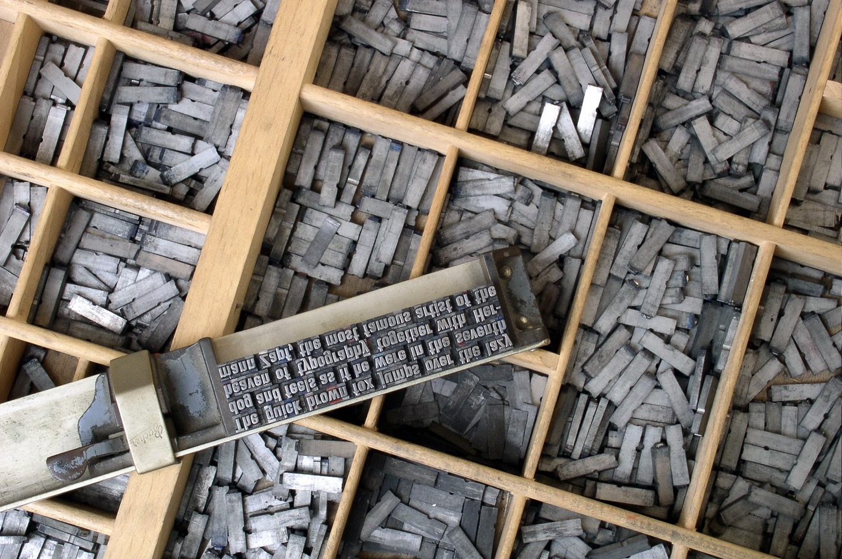

Slide 5
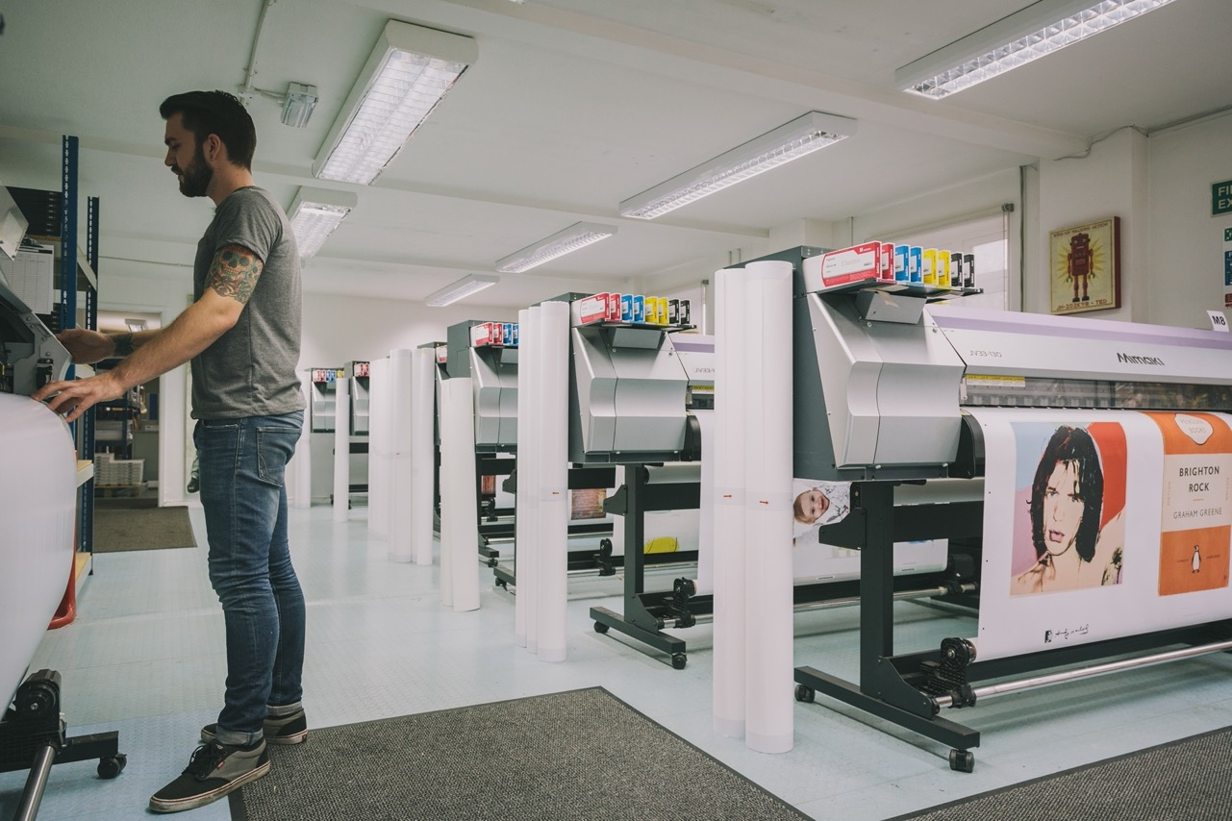

Slide 6


Slide 7
Demos

Slide 8

Notes:
Speed is a competitive advantage.

Slide 9

Notes:
We’ve build sophisticated tooling to meet our needs and handle the complexity of running in this environment called Spinnaker.

Slide 10


Slide 11

Notes:
Spinnaker is a continuous delivery platform that orchestrates the delivery of software assets.

Slide 12

Notes:
Built with plug-ability in mind

Slide 13

Notes:
Large community of participants including

Slide 14


Slide 15
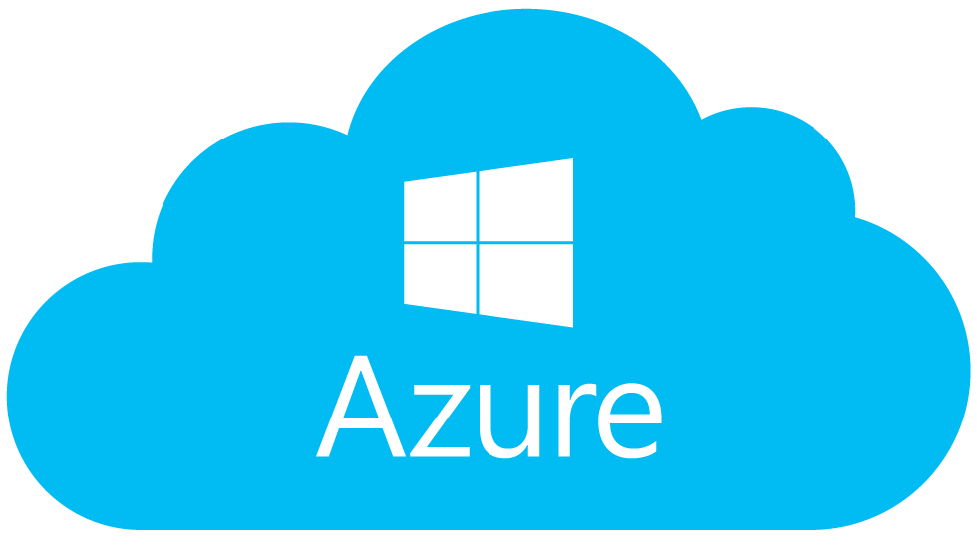

Slide 16


Slide 17
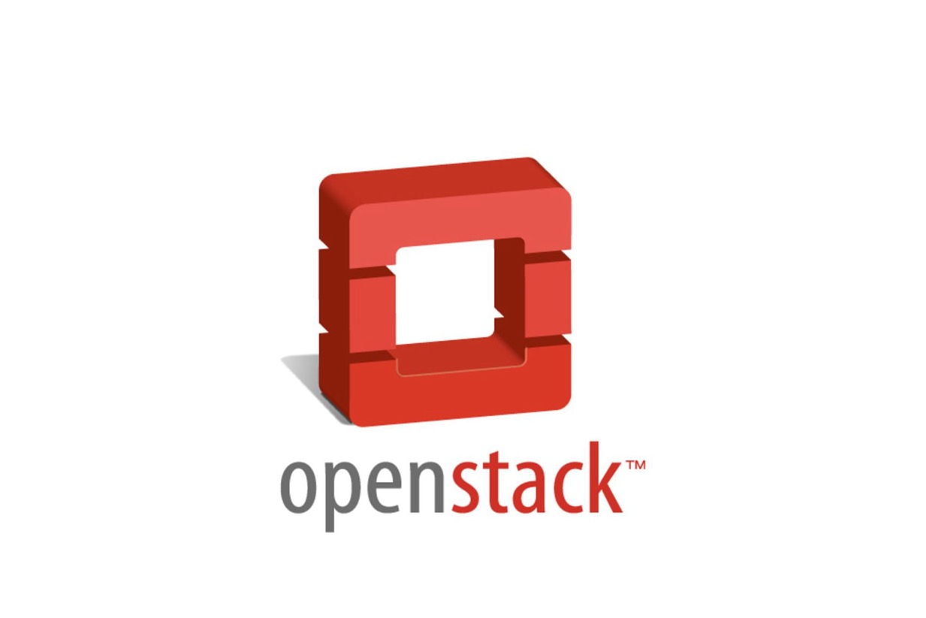

Slide 18

Notes:
6 years of CI at scale

Slide 19

Notes:
Strong opinions:
Service teams own delivery

Slide 20

Immutable
Infrastructure

Slide 21

Notes:
Codify best practices
Speed
reliablity

Slide 22

Notes:
CD about making deployments boring!

Slide 23

4,000
deployments
each day

Slide 24
Spinnaker Demo

Slide 25
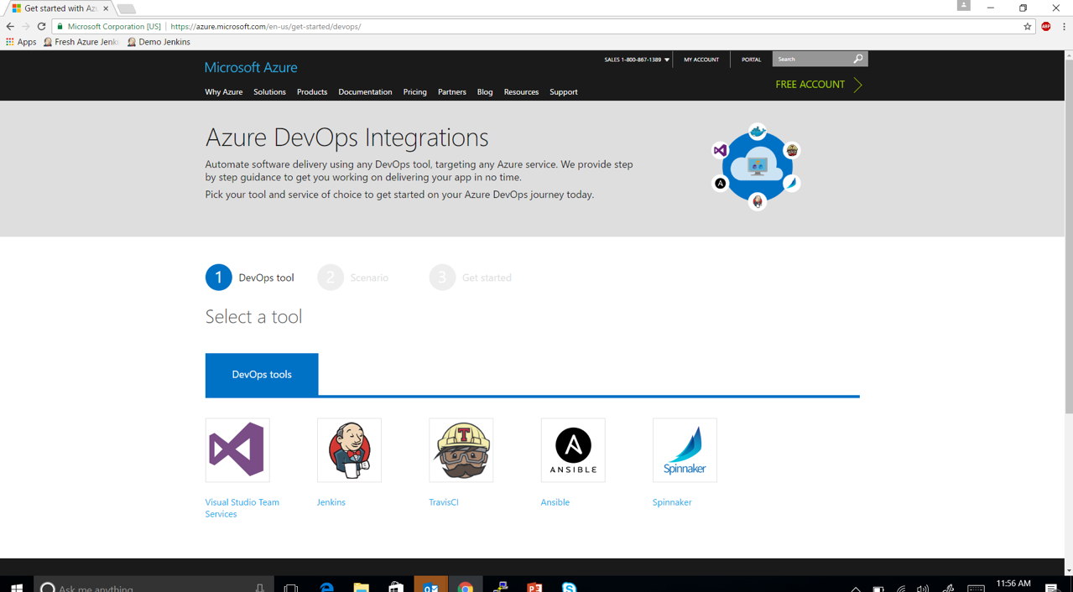
http://aka.ms/trydevops

Slide 26
Q & A

